Slide 1

Summer Training in R Programming by Board Infinity

Slide 2
INTRODUCTION
Board Infinity:
A website that offers educational resources aimed at improving knowledge and abilities.
Includes R Programming in its wide selection of courses.
Where I was fortunate to complete my summer training.
R Programming:
A powerful language for statistical programming that is used for data analysis, visualization, and other purposes.
Widely used for data-driven decision-making across many industries.
The subject of my training over the summer.

Slide 3
MY LEARNING JOURNEY
My Lerning Journey:
I begun on my R Programming journey during my summer training at Board Infinity.
It began with learning the core ideas of R and its usefulness in data analysis.
Experience Highlights:
Engaging practical experience using datasets from the actual world.
Mastered data exploration, visualization, and manipulation.
Developed problem-solving abilities through R scripting and coding.
Key Takeaways:
A strong base in the R programming language.
The capacity to use ggplot2 to produce data visualizations.
Knowledge on how to clean, analyze, and interpret data.
Knowledge of statistical principles and how to use them.
Improved capacity for critical thought and problem-solving.

Slide 4
PROGRAMMING ESSENTIALS
Foundations of R Programming:
R as a high-level, interpreted programming language.
Efficient data manipulation with vectorized procedures.
Support for data processing and visualization across a large library.
Data frames for the administration of structured data.
Basic Concepts:
Variables and data types (numeric, character, logical).
Functions and control structures (if-else, loops).
Reading and writing data (CSV, Excel, etc.).
Data cleaning and preprocessing techniques.
Skills Acquired:
Writing R code with ease.
The capacity to carry out simple data operations and calculations.
Abilities in data import, cleansing, and transformation.
Knowing how to use particular packages for particular jobs.

Slide 5
PRACTICAL APPLICATION
Project Overview:
Performed data cleaning and analysis on the dataset from Airbnb.
Built a regression model to forecast rent costs.
Role of R Programming:
Data Cleaning:
Duplicates, missing values and outliers were eliminated.
Normalized and transformed data for analysis.
Regression Modeling:
Used R programs for regression analysis, such as lm().
Constructed predictive models to project rental costs.
Results and Impact:
Enhanced data quality for more accurate analysis.
Created a predictive tool for Airbnb hosts and users.
Improved decision-making in the hospitality industry.

Slide 6
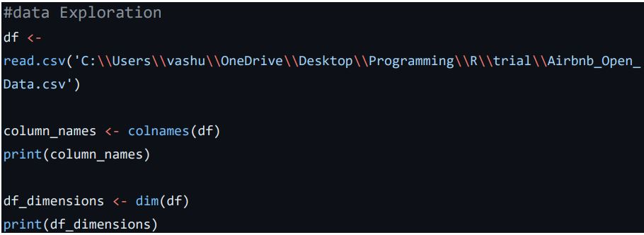
CODE FOR DATA EXPLORATION

Slide 7
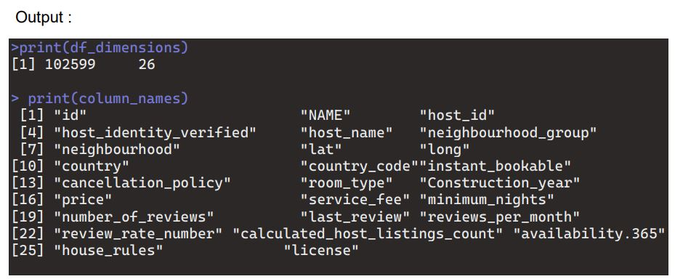
OUTPUT

Slide 8
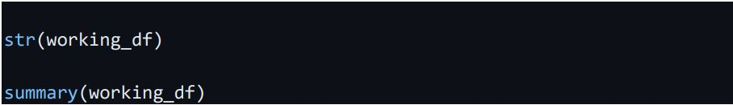
CODE FOR SUMMARY

Slide 9
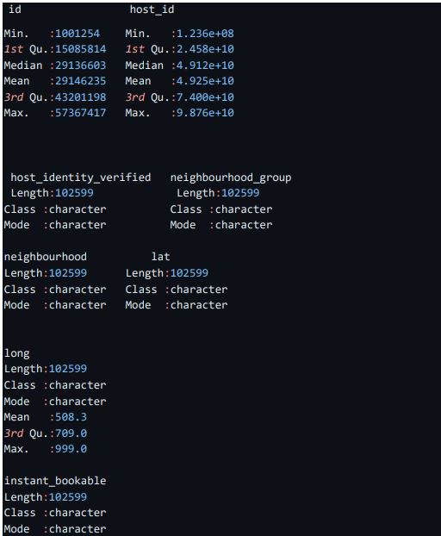
OUTPUT

Slide 10
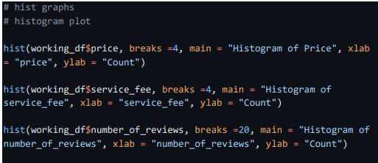
VISUALIZATIONS

Slide 11
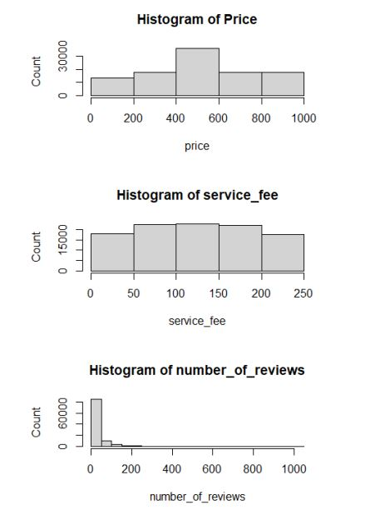
OUTPUT

Slide 12
FUTURE GOALS AND CONCLUSION
Future Goals:
Advanced Analytics:
Explore advanced R techniques for more complex data analysis.
Dive deeper into machine learning and predictive modeling.
Contributions to Data Science:
Consider writing blog posts or making contributions to the data science community to share your knowledge.
Take data science courses or certification exams.
Conclusion:
Excited about the endless possibilities in R Programming and data science.
Committed to continuous learning and growth in the field.

